Slide 1
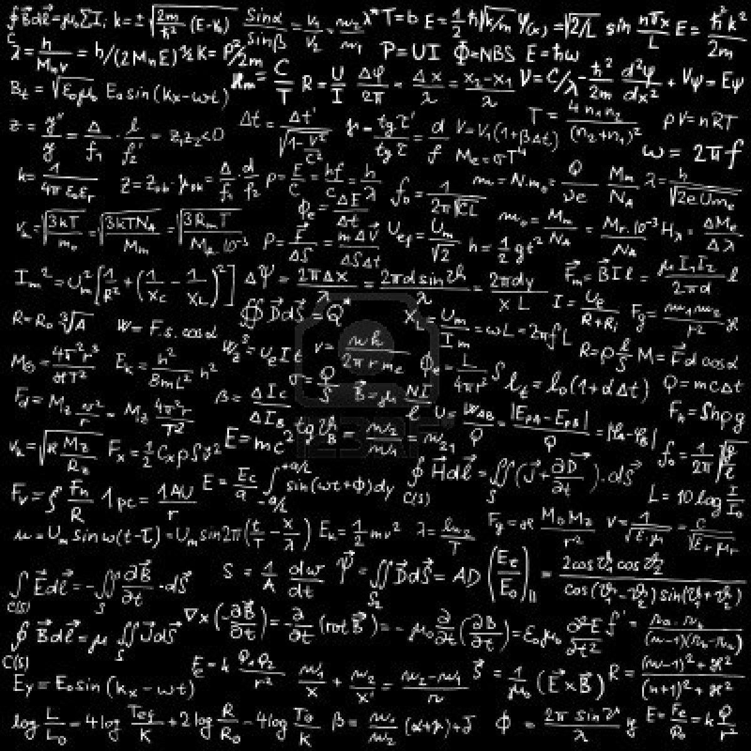
al-Farabi Kazakh National University
PARTIAL DIFFERENTIAL EQUATIONS
Professor S. Serovajsky
serovajskys@mail.ru
Almaty, 2021

Slide 2
Partial differential equations
Part I. INTRODUCTION

Slide 3
Content of Part I
3
We have three lectures to answer the following questions
about partial differential equations:

Slide 4
Content of Part I
3
We have three lectures to answer the following questions
about partial differential equations:
What is this?

Slide 5
Content of Part I
3
We have three lectures to answer the following questions
about partial differential equations:
What is this?
Why it is important?

Slide 6
Content of Part I
3
We have three lectures to answer the following questions
about partial differential equations:
What is this?
Why it is important?
How can we begin to analyze it?

Slide 7
Partial differential equations
Part I. INTRODUCTION
Lecture 1
Ordinary and partial differential equations

Slide 8
Content of the lecture
5
Three interpretations of derivative

Slide 9
Content of the lecture
5
Three interpretations of derivative
Direct and inverse differentiation problems

Slide 10
Content of the lecture
5
Three interpretations of derivative
Direct and inverse differentiation problems
Differential equation and Cauchy problem

Slide 11
Content of the lecture
5
Three interpretations of derivative
Direct and inverse differentiation problems
Differential equation and Cauchy problem
Rectilinear movement of the body

Slide 12
Content of the lecture
5
Three interpretations of derivative
Direct and inverse differentiation problems
Differential equation and Cauchy problem
Rectilinear movement of the body
Tangent plane

Slide 13
Content of the lecture
5
Three interpretations of derivative
Direct and inverse differentiation problems
Differential equation and Cauchy problem
Rectilinear movement of the body
Tangent plane
First order partial differential equations

Slide 14
Introduction
6
We have the course of partial differential equations

Slide 15
Introduction
6
We have the course of partial differential equation
Partial differential equation is an extension of the ordinary differential equation to the functions of many variables

Slide 16
Introduction
6
We have the course of partial differential equation
Partial differential equation is an extension of the ordinary differential equation to the functions of many variables
Ordinary differential equation is an equation
with unknown function under the derivative

Slide 17
Introduction
6
We have the course of partial differential equation
Partial differential equation is an extension of the ordinary differential equation to the functions of many variables
Ordinary differential equation is an equation
with unknown function under the derivative
This is based on the derivative notion

Slide 18
Three interpretations of derivative
7
Derivative is one of the most important concepts
of mathematical analysis

Slide 19
Three interpretations of derivative
7
Derivative is one of the most important concepts
of mathematical analysis
It has three different interpretations

Slide 20
Three interpretations of derivative
7
Derivative is one of the most important concepts
of mathematical analysis
It has three different interpretations
Analytic definition
Let us consider a function x=x(t)

Slide 21
Three interpretations of derivative
7
Derivative is one of the most important concepts
of mathematical analysis
It has three different interpretations
Analytic definition
Let us consider a function x=x(t)
Its derivative at a point t₀ is the following limit if it exists

Slide 22
Three interpretations of derivative
8
Geometric definition
???

Slide 23
Three interpretations of derivative
8
Geometric definition
Let us consider a curve x

Slide 24
Three interpretations of derivative
8
Geometric definition
Let us consider a curve x
The derivative is the tangent of the angle
between abscissa axe and the tangent at the considered point

Slide 25
Three interpretations of derivative
8
Geometric definition
Let us consider a curve x
The derivative is the tangent of the angle
between abscissa axe and the tangent at the considered point

Slide 26
Three interpretations of derivative
9
Mechanical definition
???

Slide 27
Three interpretations of derivative
9
Mechanical definition
Middle velocity is defined as the ratio
of the distance traveled to the travel time

Slide 28
Three interpretations of derivative
9
Mechanical definition
Middle velocity is defined as the ratio of the distance traveled to the travel time

Slide 29
Three interpretations of derivative
9
Mechanical definition
Middle velocity is defined as the ratio of the distance traveled to the travel time
Instant velocity at a time moment t₀ is the way traversed
in an arbitrarily short time

Slide 30
Three interpretations of derivative
9
Mechanical definition
Middle velocity is defined as the ratio of the distance traveled to the travel time
Instant velocity at a time moment t₀ is the way traversed
in an arbitrarily short time

Slide 31
Direct and inverse differentiation problems
10
We can have direct and inverse differentiation problems

Slide 32
Direct and inverse differentiation problems
10
We can have direct and inverse differentiation problems
Direct problems
Determine the derivative by the known function
Determine the tangent by the known curve
Determine the velocity by the known law of movement

Slide 33
Direct and inverse differentiation problems
10
We can have direct and inverse differentiation problems
Direct problems
Determine the derivative by the known function
Determine the tangent by the known curve
Determine the velocity by the known law of movement
Inverse problems
Determine the function by the known derivative
Determine the curve by the known tangent
Determine the law of movement by the known velocity
.

Slide 34
Differential equation
11
What is the differentiation inverse problem?

Slide 35
Differential equation
11
What is the differentiation inverse problem?
This is the problem of determining a function by its known derivative

Slide 36
Differential equation
11
What is the differentiation inverse problem?
This is the problem of determining a function by its known derivative
We have the equation
with respect to the function x, where the function f is given

Slide 37
Differential equation
11
What is the differentiation inverse problem?
This is the problem of determining a function by its known derivative
We have the equation
with respect to the function x, where the function f is given
What is this?

Slide 38
Differential equation
11
What is the differentiation inverse problem?
This is the problem of determining a function by its known derivative
We have the equation
with respect to the function x, where the function f is given
This equation is called the differential equation,
because we have the unknown function x
under the differentiation operation

Slide 39
Cauchy problem
12
For the easiest situation with constant f, we can determine the function
that satisfies the given equation for all constant c

Slide 40
Cauchy problem
12
For the easiest situation with constant f, we can determine the function
that satisfies the given equation for all constant c
This equality gives what?

Slide 41
Cauchy problem
12
For the easiest situation with constant f, we can determine the function
that satisfies the given equation for all constant c
This equality gives the general solution of the this equation

Slide 42
Cauchy problem
12
For the easiest situation with constant f, we can determine the function
that satisfies the given equation for all constant c
This equality gives the general solution of the this equation
Solution of differential equations can be determined accurate to a constant

Slide 43
Cauchy problem
12
For the easiest situation with constant f, we can determine the function
that satisfies the given equation for all constant c
This equality gives the general solution of the this equation
Solution of differential equations can be determined accurate to a constant
Partial solution of the equation is its general solution
with concrete value of the constant c

Slide 44
Cauchy problem
12
For the easiest situation with constant f, we can determine the function
that satisfies the given equation for all constant c
This equality gives the general solution of the this equation
Solution of differential equations can be determined accurate to a constant
Partial solution of the equation is its general solution
with concrete value of the constant c
If we would like to determine the concrete function,
then it is necessary to add what?

Slide 45
Cauchy problem
12
For the easiest situation with constant f, we can determine the function
that satisfies the given equation for all constant c
This equality gives the general solution of the this equation
Solution of differential equations can be determined accurate to a constant
Partial solution of the equation is its general solution
with concrete value of the constant c
If we would like to determine the concrete function,
then it is necessary to add an initial condition
where t_{o} and x_{o} are given

Slide 46
Cauchy problem
12
For the easiest situation with constant f, we can determine the function
that satisfies the given equation for all constant c
This equality gives the general solution of the this equation
Solution of differential equations can be determined accurate to a constant
Partial solution of the equation is its general solution
with concrete value of the constant c
If we would like to determine the concrete function,
then it is necessary to add an initial condition
where t_{o} and x_{o} are given
The differential equation with initial condition is called ???

Slide 47
Cauchy problem
12
For the easiest situation with constant f, we can determine the function
that satisfies the given equation for all constant c
This equality gives the general solution of the this equation
Solution of differential equations can be determined accurate to a constant
Partial solution of the equation is its general solution
with concrete value of the constant c
If we would like to determine the concrete function,
then it is necessary to add an initial condition
where t_{o} and x_{o} are given
The differential equation with initial condition is called Cauchy problem

Slide 48
Rectilinear movement of the body
13
Consider as an example the rectilinear movement of the body

Slide 49
Rectilinear movement of the body
13
Consider as an example the rectilinear movement of the body
By the second Newton law, the movement is characterized
by the equality F = ma,
where F ­is the force, m is the mass, and a is the acceleration

Slide 50
Rectilinear movement of the body
13
Consider as an example the rectilinear movement of the body
By the second Newton law, the movement is characterized
by the equality F = ma,
where F ­is the force, m is the mass, and a is the acceleration
Acceleration is the second derivative of the body coordinate
Вопрос: что мы наблюдаем?

Slide 51
Rectilinear movement of the body
13
Consider as an example the rectilinear movement of the body
By the second Newton law, the movement is characterized
by the equality F = ma,
where F ­is the force, m is the mass, and a is the acceleration
Acceleration is the second derivative of the body coordinate
Вопрос: что мы наблюдаем?
This is the second order differential equation

Slide 52
Rectilinear movement of the body
13
Consider as an example the rectilinear movement of the body
By the second Newton law, the movement is characterized
by the equality F = ma,
where F ­is the force, m is the mass, and a is the acceleration
Acceleration is the second derivative of the body coordinate
Вопрос: что мы наблюдаем?
This is the second order differential equation
Вывод: состояние системы описывается функцией
where c₁ and c₂ are arbitrary constants

Slide 53
Rectilinear movement of the body
13
Consider as an example the rectilinear movement of the body
By the second Newton law, the movement is characterized
by the equality F = ma,
where F ­is the force, m is the mass, and a is the acceleration
Acceleration is the second derivative of the body coordinate
Вопрос: что мы наблюдаем?
This is the second order differential equation
Вывод: состояние системы описывается функцией
where c₁ and c₂ are arbitrary constants
Add initial conditions for finding it

Slide 54
Tangent plane
14
Function of one variable determines a curve on the plane

Slide 55
Tangent plane
14
Function of one variable determines a curve on the plane
Function of two variables determines a surface in the space

Slide 56
Tangent plane
14
Function of one variable determines a curve on the plane
Function of two variables determines a surface in the space
Two-dimensional analogue of the tangent to the curve at a point
is the tangent plane to the surface at the concrete point

Slide 57
Tangent plane
14
Function of one variable determines a curve on the plane
Function of two variables determines a surface in the space
Two-dimensional analogue of the tangent to the curve at a point
is the tangent plane to the surface at the concrete point
Equation of the tangent line to the curve x=x(t)
at the point t₀ is determined by the formula

Slide 58
Tangent plane
14
Function of one variable determines a curve on the plane
Function of two variables determines a surface in the space
Two-dimensional analogue of the tangent to the curve at a point
is the tangent plane to the surface at the concrete point
Equation of the tangent line to the curve x=x(t)
at the point t₀ is determined by the formula
Equation of the tangent plane to the surface u=u(x,y)
at the point (x₀,y₀) is determined by the formula

Slide 59
Tangent plane
14
Function of one variable determines a curve on the plane
Function of two variables determines a surface in the space
Two-dimensional analogue of the tangent to the curve at a point
is the tangent plane to the surface at the concrete point
Equation of the tangent line to the curve x=x(t)
at the point t₀ is determined by the formula
Equation of the tangent plane to the surface u=u(x,y)
at the point (x₀,y₀) is determined by the formula
where u_{x} and u_{y} are the partial derivatives of the function u

Slide 60
Partial differential equation
15
Inverse problem for the one-dimensional case
is determining the curve by its tangent line
that is the ordinary differential equation

Slide 61
Partial differential equation
15
Inverse problem for the one-dimensional case
is determining the curve by its tangent line
that is the ordinary differential equation
Inverse problem for the two-dimensional case
is determining the surface by its tangent plane
that is the partial differential equation

Slide 62
First order partial differential equations
16
Consider easiest first order partial differential equation
where a is given positive constant

Slide 63
First order partial differential equations
16
Consider easiest first order partial differential equation
where a is given positive constant
Consider the family of functions
with arbitrary parameter b

Slide 64
First order partial differential equations
16
Consider easiest first order partial differential equation
where a is given positive constant
Consider the family of functions
with arbitrary parameter b
These functions are called the characteristics of the equation

Slide 65
First order partial differential equations
16
Consider easiest first order partial differential equation
where a is given positive constant
Consider the family of functions
with arbitrary parameter b
These functions are called the characteristics of the equation
Determine the solution of the equation on the characteristic
with concrete parameter b

Slide 66
First order partial differential equations
17

Slide 67
First order partial differential equations
17
Find the derivative of the function

Slide 68
First order partial differential equations
17
Find the derivative of the function

Slide 69
First order partial differential equations
17
Find the derivative of the function
Conclusion
The function f is constant

Slide 70
First order partial differential equations
17
Find the derivative of the function
Conclusion
The function f is constant
The solution of the considered equation
has the same value on each characteristic

Slide 71
First order partial differential equations
18
Consider the equation
in the rectangle 0<x<L, 0<y<M

Slide 72
First order partial differential equations
18
Consider the equation
in the rectangle 0<x<L, 0<y<M with boundary conditions

Slide 73
First order partial differential equations
18
Consider the equation
in the rectangle 0<x<L, 0<y<M with boundary conditions

Slide 74
First order partial differential equations
19

Slide 75
First order partial differential equations
19
How we determine the solution of the boundary problem
at the concrete point (x,y)?

Slide 76
First order partial differential equations
19
How we determine the solution of the boundary problem
at the concrete point (x,y)?
Find the characteristic that passes through this point

Slide 77
First order partial differential equations
19
How we determine the solution of the boundary problem
at the concrete point (x,y)?
Find the characteristic that passes through this point
Determine the concrete constant b that satisfies the equality ax+b=y

Slide 78
First order partial differential equations
19
How we determine the solution of the boundary problem
at the concrete point (x,y)?
Find the characteristic that passes through this point
Determine the concrete constant b that satisfies the equality ax+b=y
If b>0, then this characteristic passes the boundary x=0 of rectangle

Slide 79
First order partial differential equations
19
How we determine the solution of the boundary problem
at the concrete point (x,y)?
Find the characteristic that passes through this point
Determine the concrete constant b that satisfies the equality ax+b=y
If b>0, then this characteristic passes the boundary x=0 of rectangle
Corresponding point of boundary is η=b

Slide 80
First order partial differential equations
19
How we determine the solution of the boundary problem
at the concrete point (x,y)?
Find the characteristic that passes through this point
Determine the concrete constant b that satisfies the equality ax+b=y
If b>0, then this characteristic passes the boundary x=0 of rectangle
Corresponding point of boundary is η=b
Then determine u(x,y)=f(η)=f(y-ax)

Slide 81
First order partial differential equations
20
Determine the constant b that satisfies the equality ax+b=y, i.e. b=y–ax

Slide 82
First order partial differential equations
20
Determine the constant b that satisfies the equality ax+b=y, i.e. b=y–ax
If b<0, then this characteristic passes the boundary y=0 of rectangle

Slide 83
First order partial differential equations
20
Determine the constant b that satisfies the equality ax+b=y, i.e. b=y–ax
If b<0, then this characteristic passes the boundary y=0 of rectangle
The corresponding point of boundary is ξ=-b/a

Slide 84
First order partial differential equations
20
Determine the constant b that satisfies the equality ax+b=y, i.e. b=y–ax
If b<0, then this characteristic passes the boundary y=0 of rectangle
The corresponding point of boundary is ξ=-b/a
Now we determine u(x,y)=g(ξ)=g(x-y/a)

Slide 85
First order partial differential equations
20
Determine the constant b that satisfies the equality ax+b=y, i.e. b=y–ax
If b<0, then this characteristic passes the boundary y=0 of rectangle
The corresponding point of boundary is ξ=-b/a
Now we determine u(x,y)=g(ξ)=g(x-y/a)
Solution of the problem

Slide 86
Conclusions
21
Derivative has analytic, geometric and mechanic interpretations

Slide 87
Conclusions
21
Derivative has analytic, geometric and mechanic interpretations
There exist the direct and inverse differentiation problems

Slide 88
Conclusions
21
Derivative has analytic, geometric and mechanic interpretations
There exist the direct and inverse differentiation problems
Inverse differentiation problem is the determining the function by its derivative

Slide 89
Conclusions
21
Derivative has analytic, geometric and mechanic interpretations
There exist the direct and inverse differentiation problems
Inverse differentiation problem is the determining the function by its derivative
Inverse differentiation problem is an ordinary differential equation

Slide 90
Conclusions
21
Derivative has analytic, geometric and mechanic interpretations
There exist the direct and inverse differentiation problems
Inverse differentiation problem is the determining the function by its derivative
Inverse differentiation problem is an ordinary differential equation
Ordinary differential equation is an equation with unknown function under the derivative

Slide 91
Conclusions
21
Derivative has analytic, geometric and mechanic interpretations
There exist the direct and inverse differentiation problems
Inverse differentiation problem is the determining the function by its derivative
Inverse differentiation problem is an ordinary differential equation
Ordinary differential equation is an equation with unknown function under the derivative
Ordinary differential equations have physical and geometric sense because of the derivative definition

Slide 92
Conclusions
22
Equation order is the maximal order of the unknown function derivative in the equation

Slide 93
Conclusions
22
Equation order is the maximal order of the unknown function derivative in the equation
General solution of the differential equation depends from arbitrary constants

Slide 94
Conclusions
22
Equation order is the maximal order of the unknown function derivative in the equation
General solution of the differential equation depends from arbitrary constants
Quantity of the arbitrary constants is equal to the equation order

Slide 95
Conclusions
22
Equation order is the maximal order of the unknown function derivative in the equation
General solution of the differential equation depends from arbitrary constants
Quantity of the arbitrary constants is equal to the equation order
It is necessary to have additional conditions for finding partial solution of the equation

Slide 96
Conclusions
23
Partial differential equation is an extension of the ordinary differential equation to the functions of many variables

Slide 97
Conclusions
23
Partial differential equation is an extension of the ordinary differential equation to the functions of many variables
Easiest partial differential equation is the problem of determining a surface by known tangent plane

Slide 98
Conclusions
23
Partial differential equation is an extension of the ordinary differential equation to the functions of many variables
Easiest partial differential equation is the problem of determining a surface by known tangent plane
This is first order partial differential equation with respect to the function of two variables

Slide 99
Conclusions
23
Partial differential equation is an extension of the ordinary differential equation to the functions of many variables
Easiest partial differential equation is the problem of determining a surface by known tangent plane
This is first order partial differential equation with respect to the function of two variables
This equation can be solved by the characteristic method

Slide 100
Conclusions
23
Partial differential equation is an extension of the ordinary differential equation to the functions of many variables
Easiest partial differential equation is the problem of determining a surface by known tangent plane
This is first order partial differential equation with respect to the function of two variables
This equation can be solved by the characteristic method
It is necessary to have additional functional conditions for finding the concrete solution of the partial differential equation

Slide 101
Task
24
Solving of boundary problems
for ordinary differential equations

Slide 102
Next step
24
Why it is important?

Slide 103
Next step
24
Why it is important?
Partial differential equations
as mathematical models
of physical processes

